Slide 1
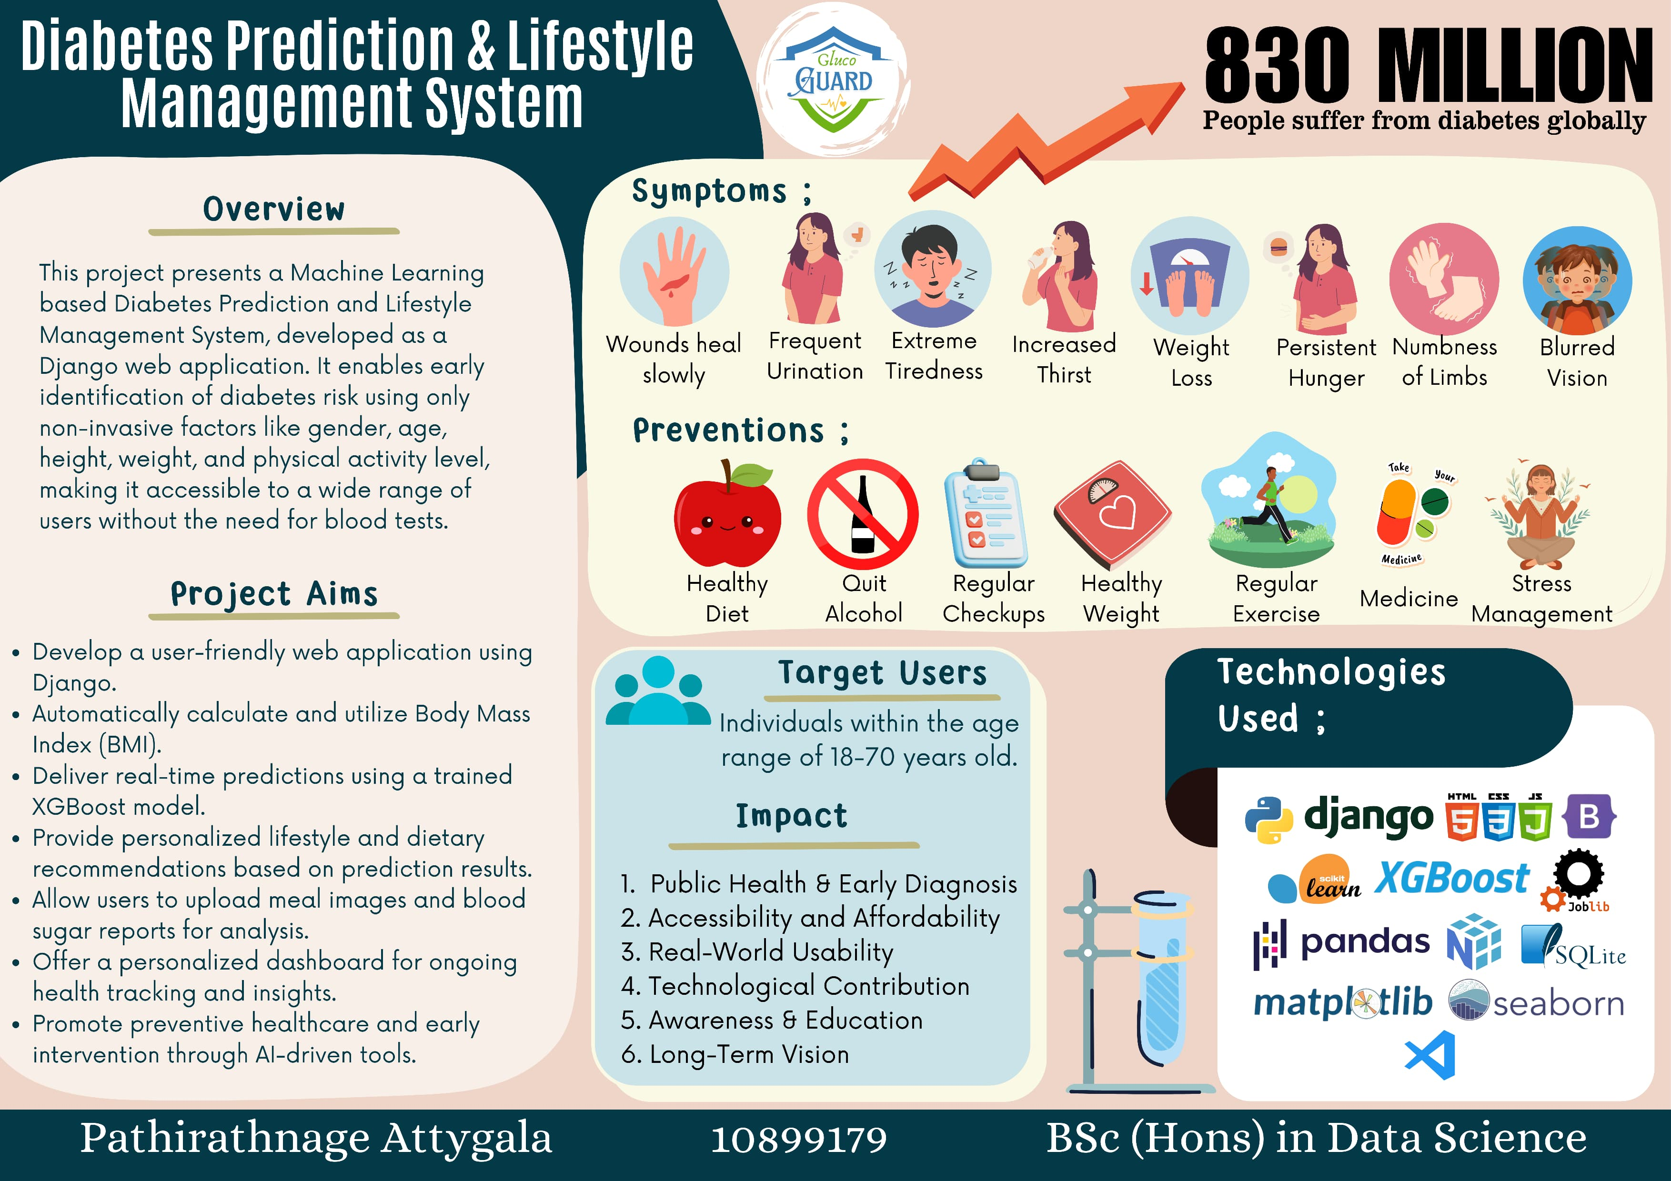

Slide 2

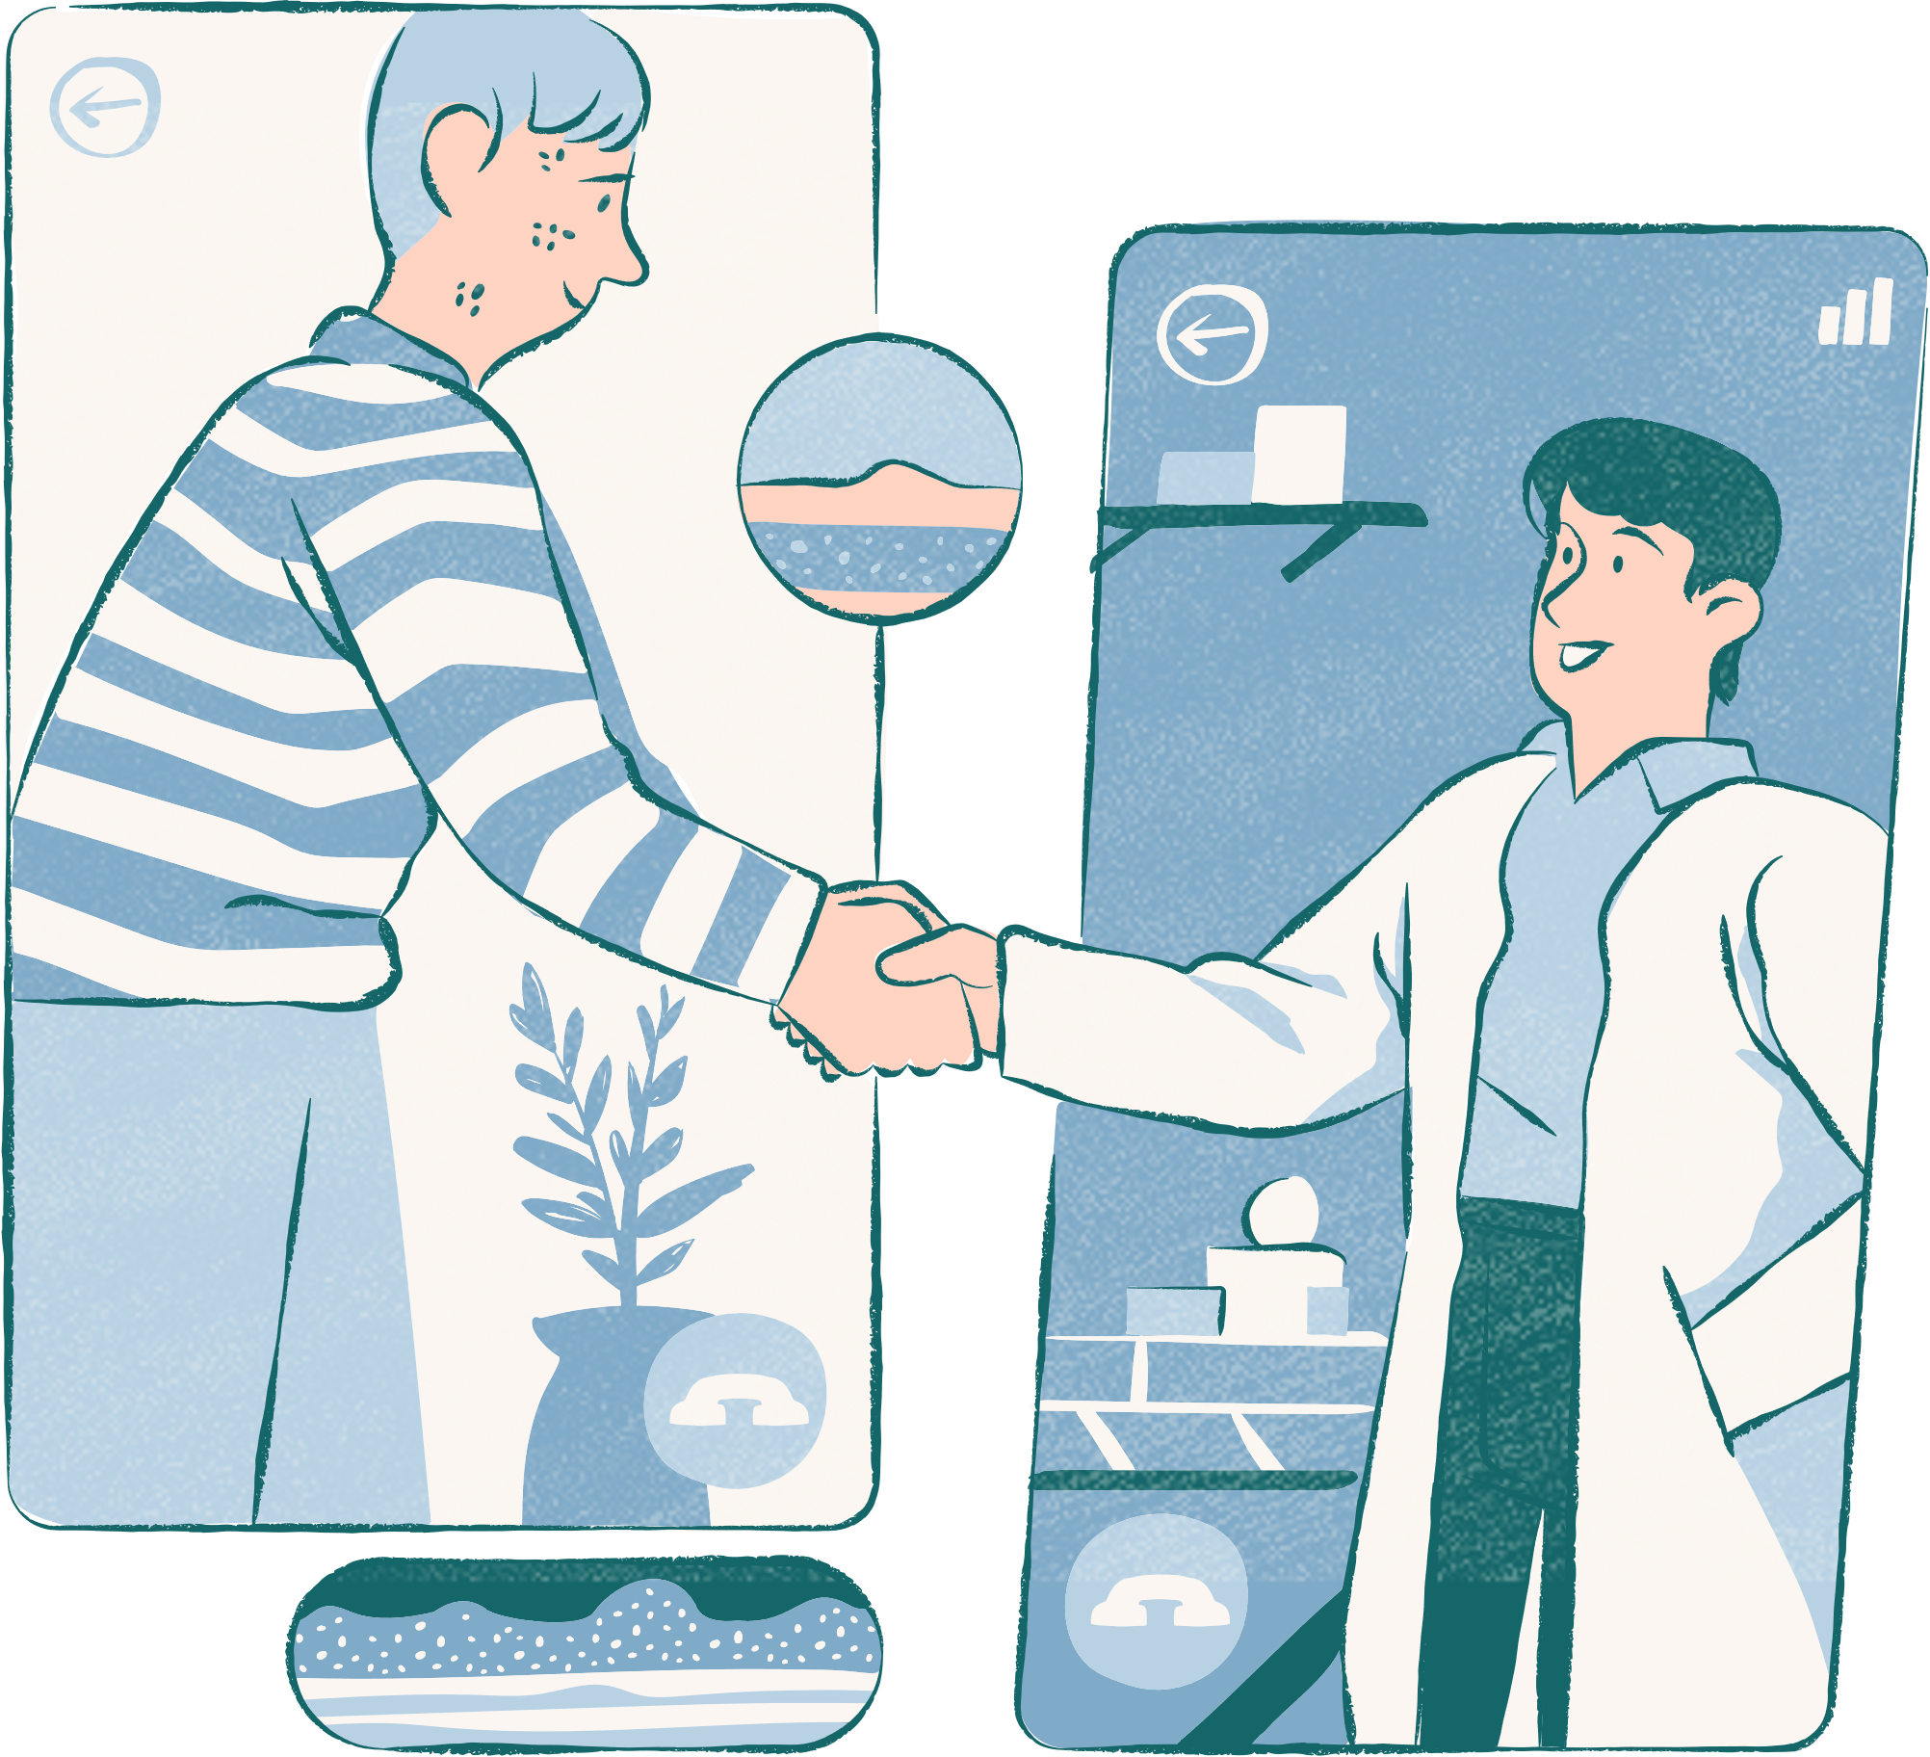
GlucoGuard
Diabetes Prediction & Lifestyle Management System
Name: Pathirathnage M Attygala
Plymouth ID: 10899179

Slide 3
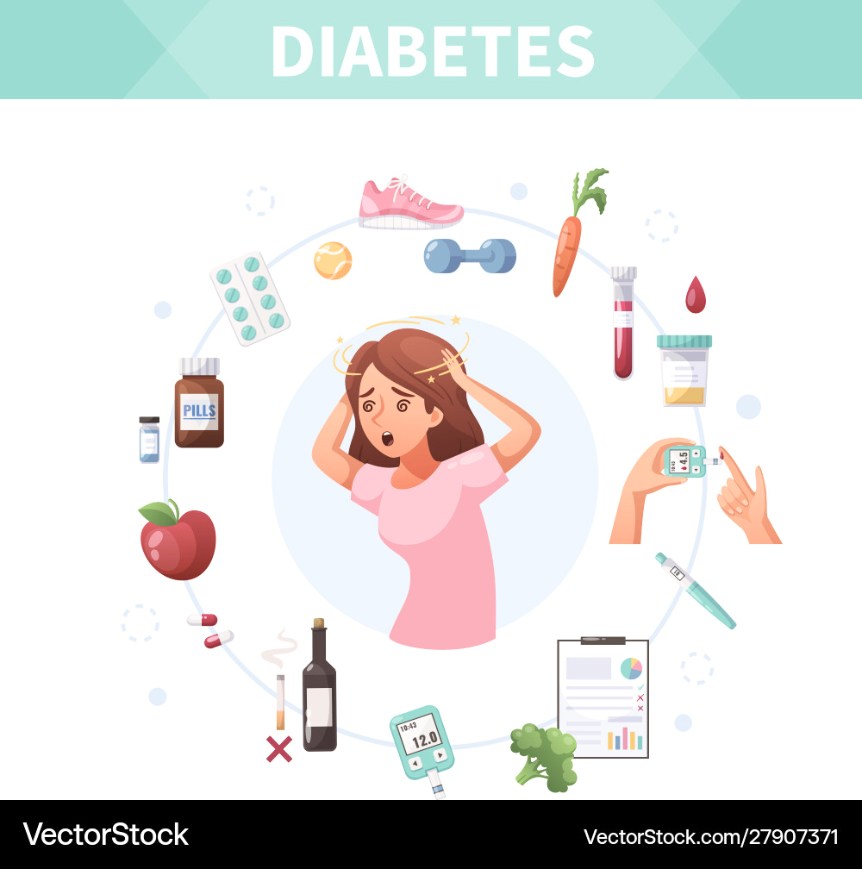
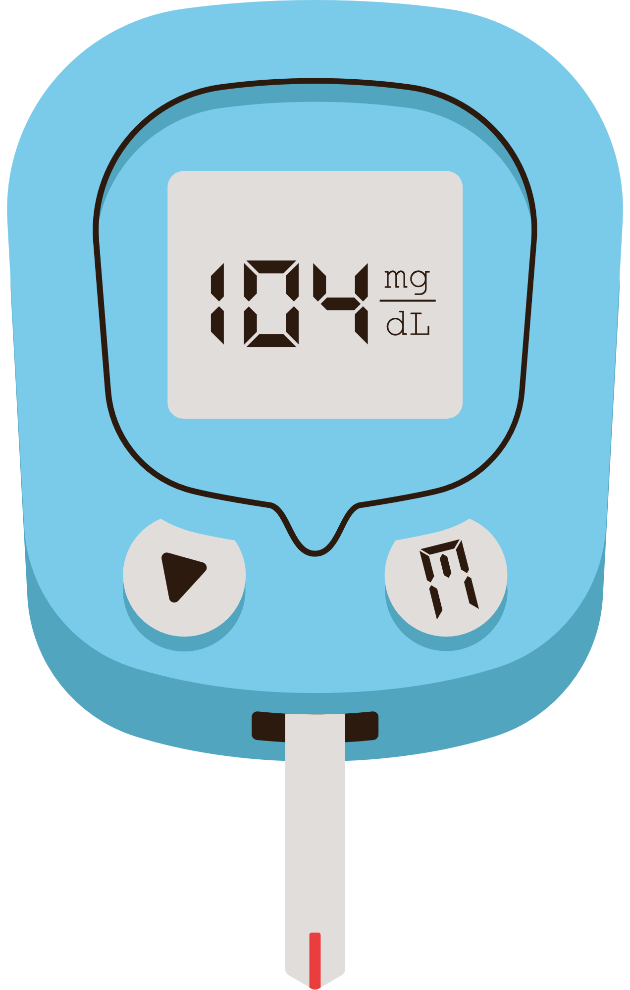
What is Diabetes ?
Diabetes is a chronic health condition that affects how the body converts food into energy. It occurs when the body doesn’t produce enough insulin or can’t use insulin effectively, causing blood sugar levels to rise.
There are two main types:
Type 1 diabetes: An autoimmune condition where the body stops making insulin.
Type 2 diabetes: The most common form, often linked to lifestyle factors like poor diet, lack of physical activity, and obesity.
Without proper management, diabetes can lead to serious health complications such as heart disease, kidney failure, nerve damage, and vision loss. Early detection and healthy lifestyle habits can significantly reduce these risks.
Diabetes Levels of a Normal Person
- Fasting: 70–99 mg/dL
- Random: < 140 mg/dL

Slide 4

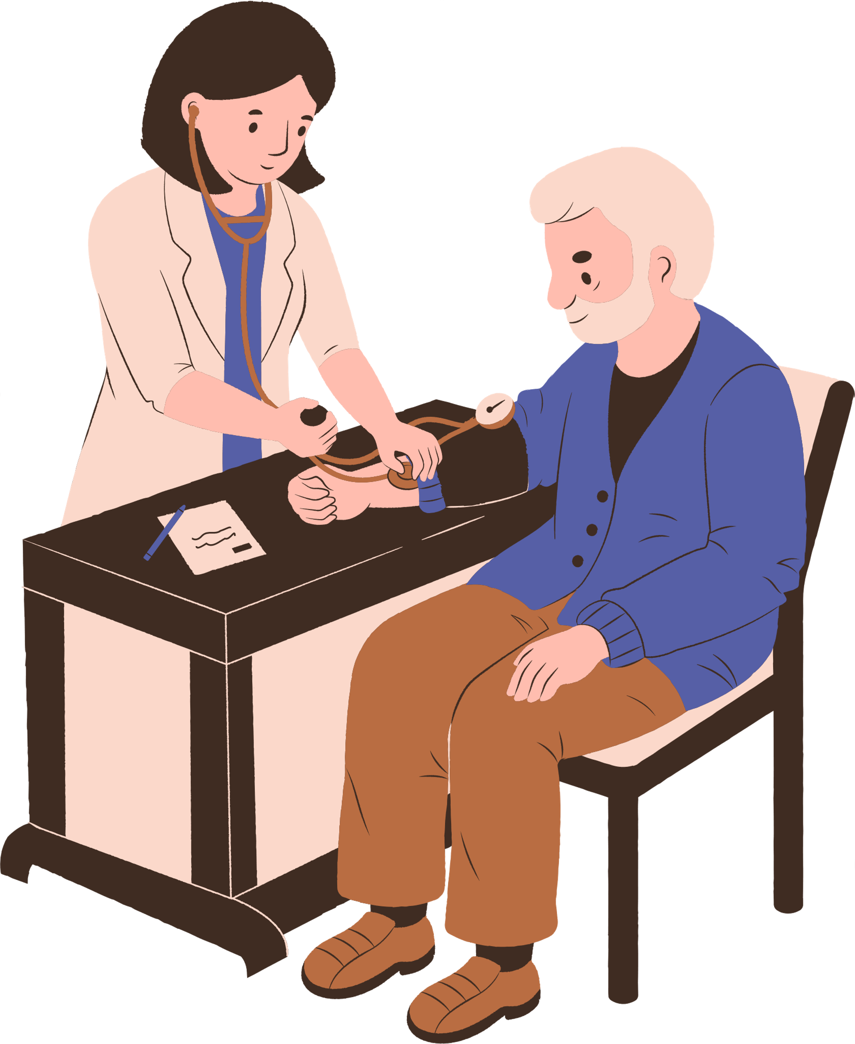
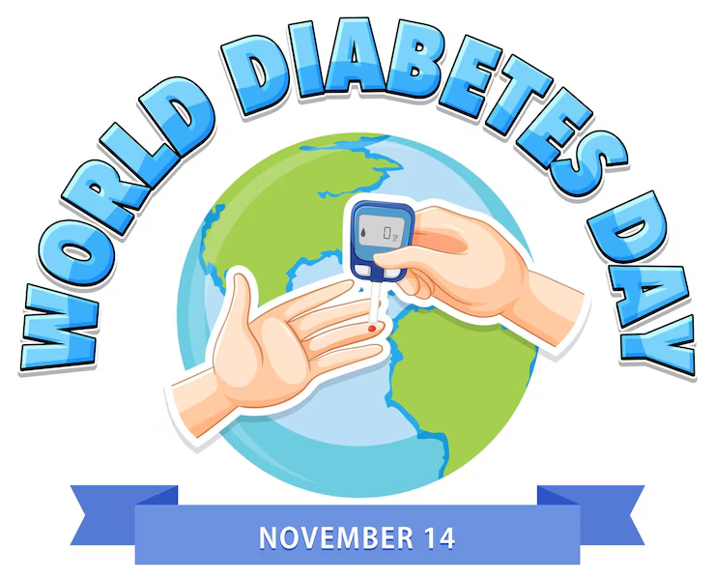
Global Impact of Diabetes
Diabetes is a growing global health concern:
Over 537 million adults (aged 18–70) are living with diabetes worldwide.
1 in 10 adults has diabetes, about 830 million people world wide have diabetes.
Most cases are type 2 diabetes, which is largely preventable with healthy habits.
How Diabetes Occurs in People
- Unhealthy diet (high in sugar and processed food)
- Lack of physical activity
- Excess body fat, especially around the belly
- Aging (risk increases after age 45)
- Family history of diabetes
- High blood pressure or cholesterol

Slide 5
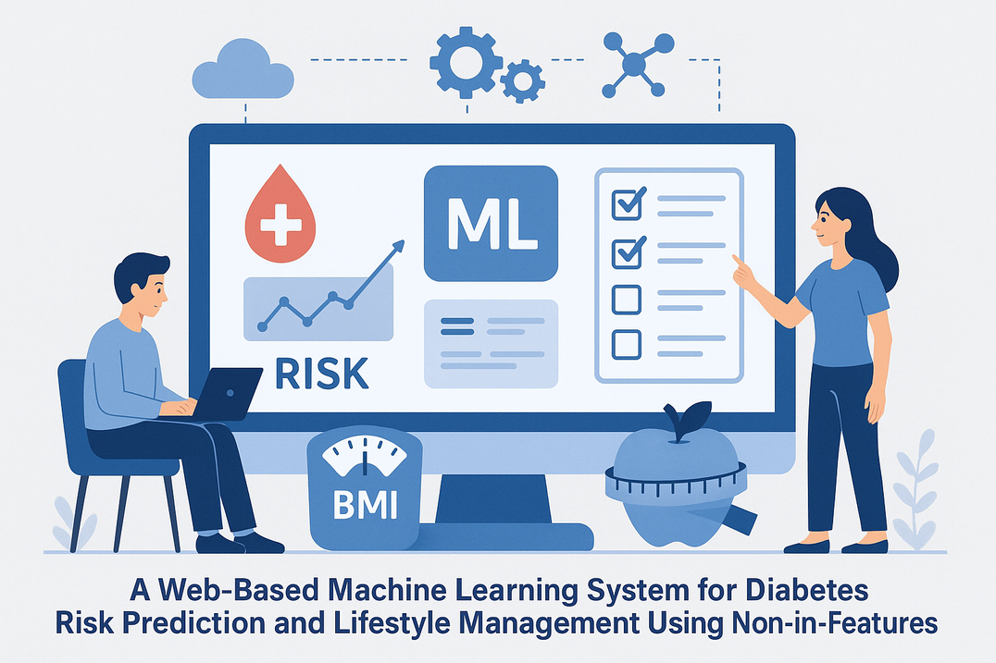
Project
A Web-Based Machine Learning System for Diabetes Risk Prediction and Lifestyle Management Using Non-Invasive Features

Slide 6

What the Project is About
Objective: Predict diabetes risk using machine learning in a user-friendly web app.
Input Parameters:
Age
Gender
Height & Weight (for BMI calculation)
Physical activity level
Core Functionality:
Calculates BMI
Predicts diabetes risk using a trained ML model
Output:
Risk assessment result (at risk / not at risk)
Personalized health advice
Additional Features:
Interactive user dashboard
Health tracking tools
Lifestyle management support
Impact:
Non-invasive, early risk detection
Encourages preventive health habits

Slide 7

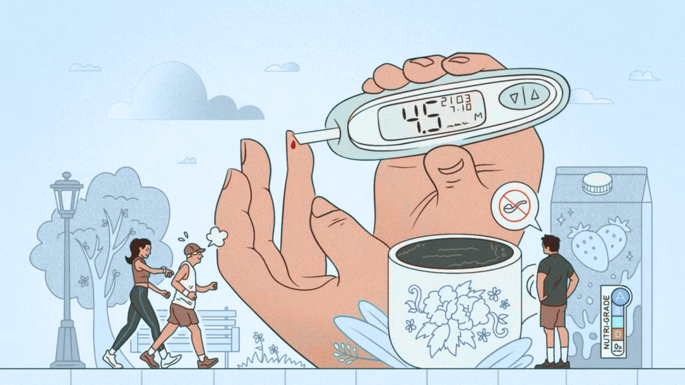
Why It Was Created
Global Issue:
Diabetes affects 830+ million people worldwide
Many remain undiagnosed due to subtle early symptoms or lack of access to testing
Challenges with Existing Tools:
Often invasive, costly, or inaccessible
My Solution:
A non-invasive, low-cost, and easy-to-use web application
Designed for users aged 18–70, especially those at risk due to lifestyle
Key Goals:
Promote early diagnosis and health awareness
Support preventive healthcare
Empower individuals to manage their well-being proactively

Slide 8

How It Works
System Workflow & Features
User Input via Web Interface:
Age, gender, height, weight, physical activity level
Automatic BMI Calculation
Real-Time Risk Prediction:
Uses trained XGBoost ML model
Instantly assesses diabetes risk
Personalized Output:
Tailored lifestyle & dietary advice
Health Monitoring Tools:
Meal image uploads for dietary tracking
Blood sugar report uploads
User Dashboard:
View past entries & health trends
Access previous recommendations
Educational resources on symptoms & prevention

Slide 9
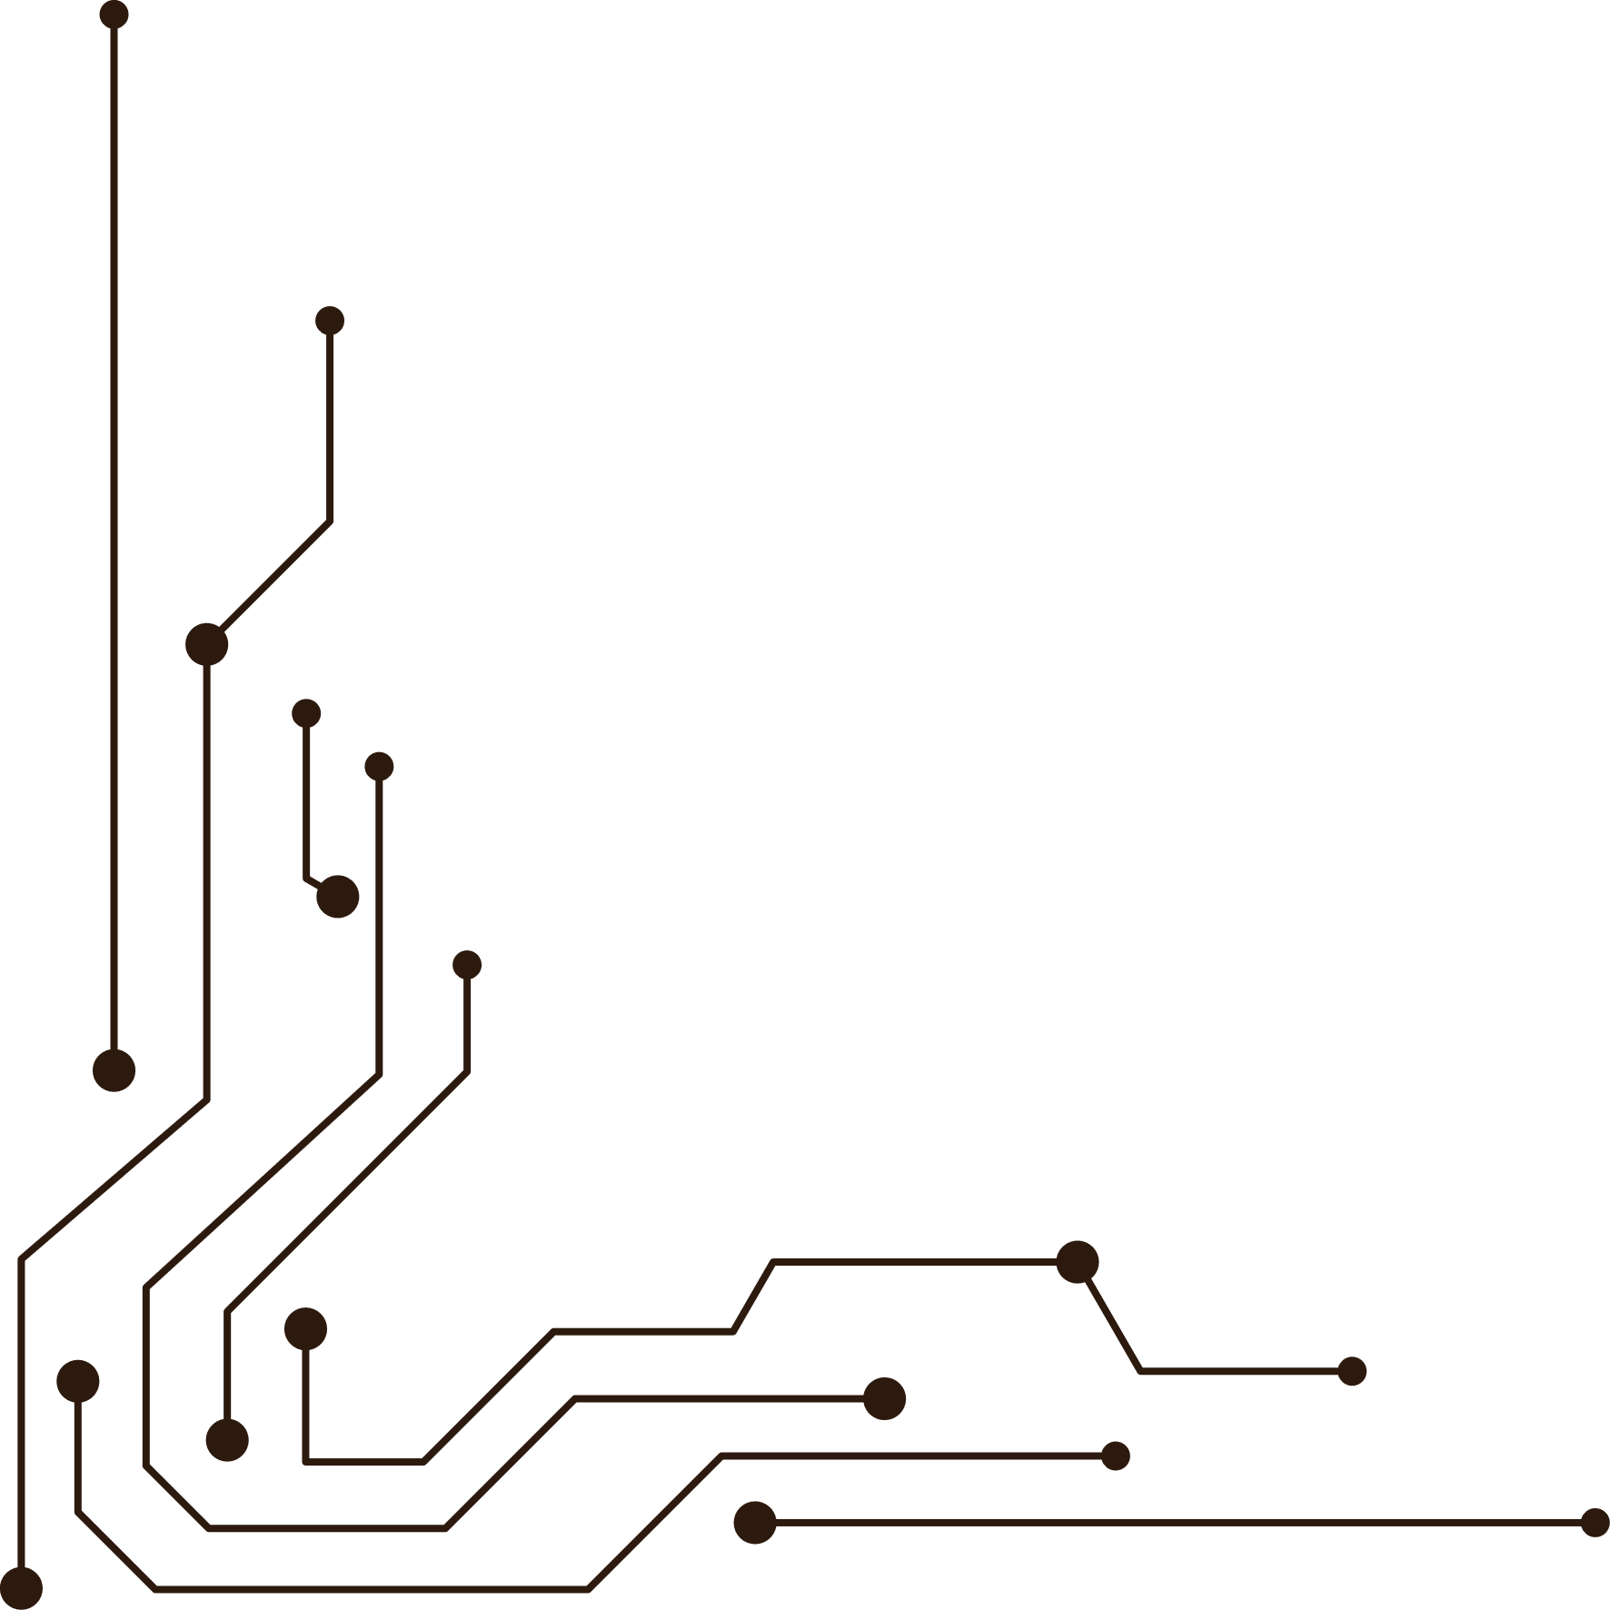





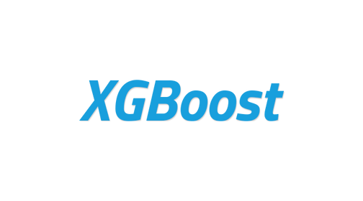







Technologies Used
Backend:
Django (Python) – Fast, scalable web framework
Machine Learning:
XGBoost – High-accuracy model for diabetes prediction
scikit-learn – Preprocessing & model support
pandas – Data handling & analysis
Joblib – Model serialization & deployment
Data Visualization:
matplotlib, seaborn – Graphs and visual analytics
Frontend:
HTML, CSS, Bootstrap, JavaScript – Responsive UI design
Database:
SQLite – Lightweight, integrated database
Development Tools:
VS Code – Code editor for efficient development

Slide 10
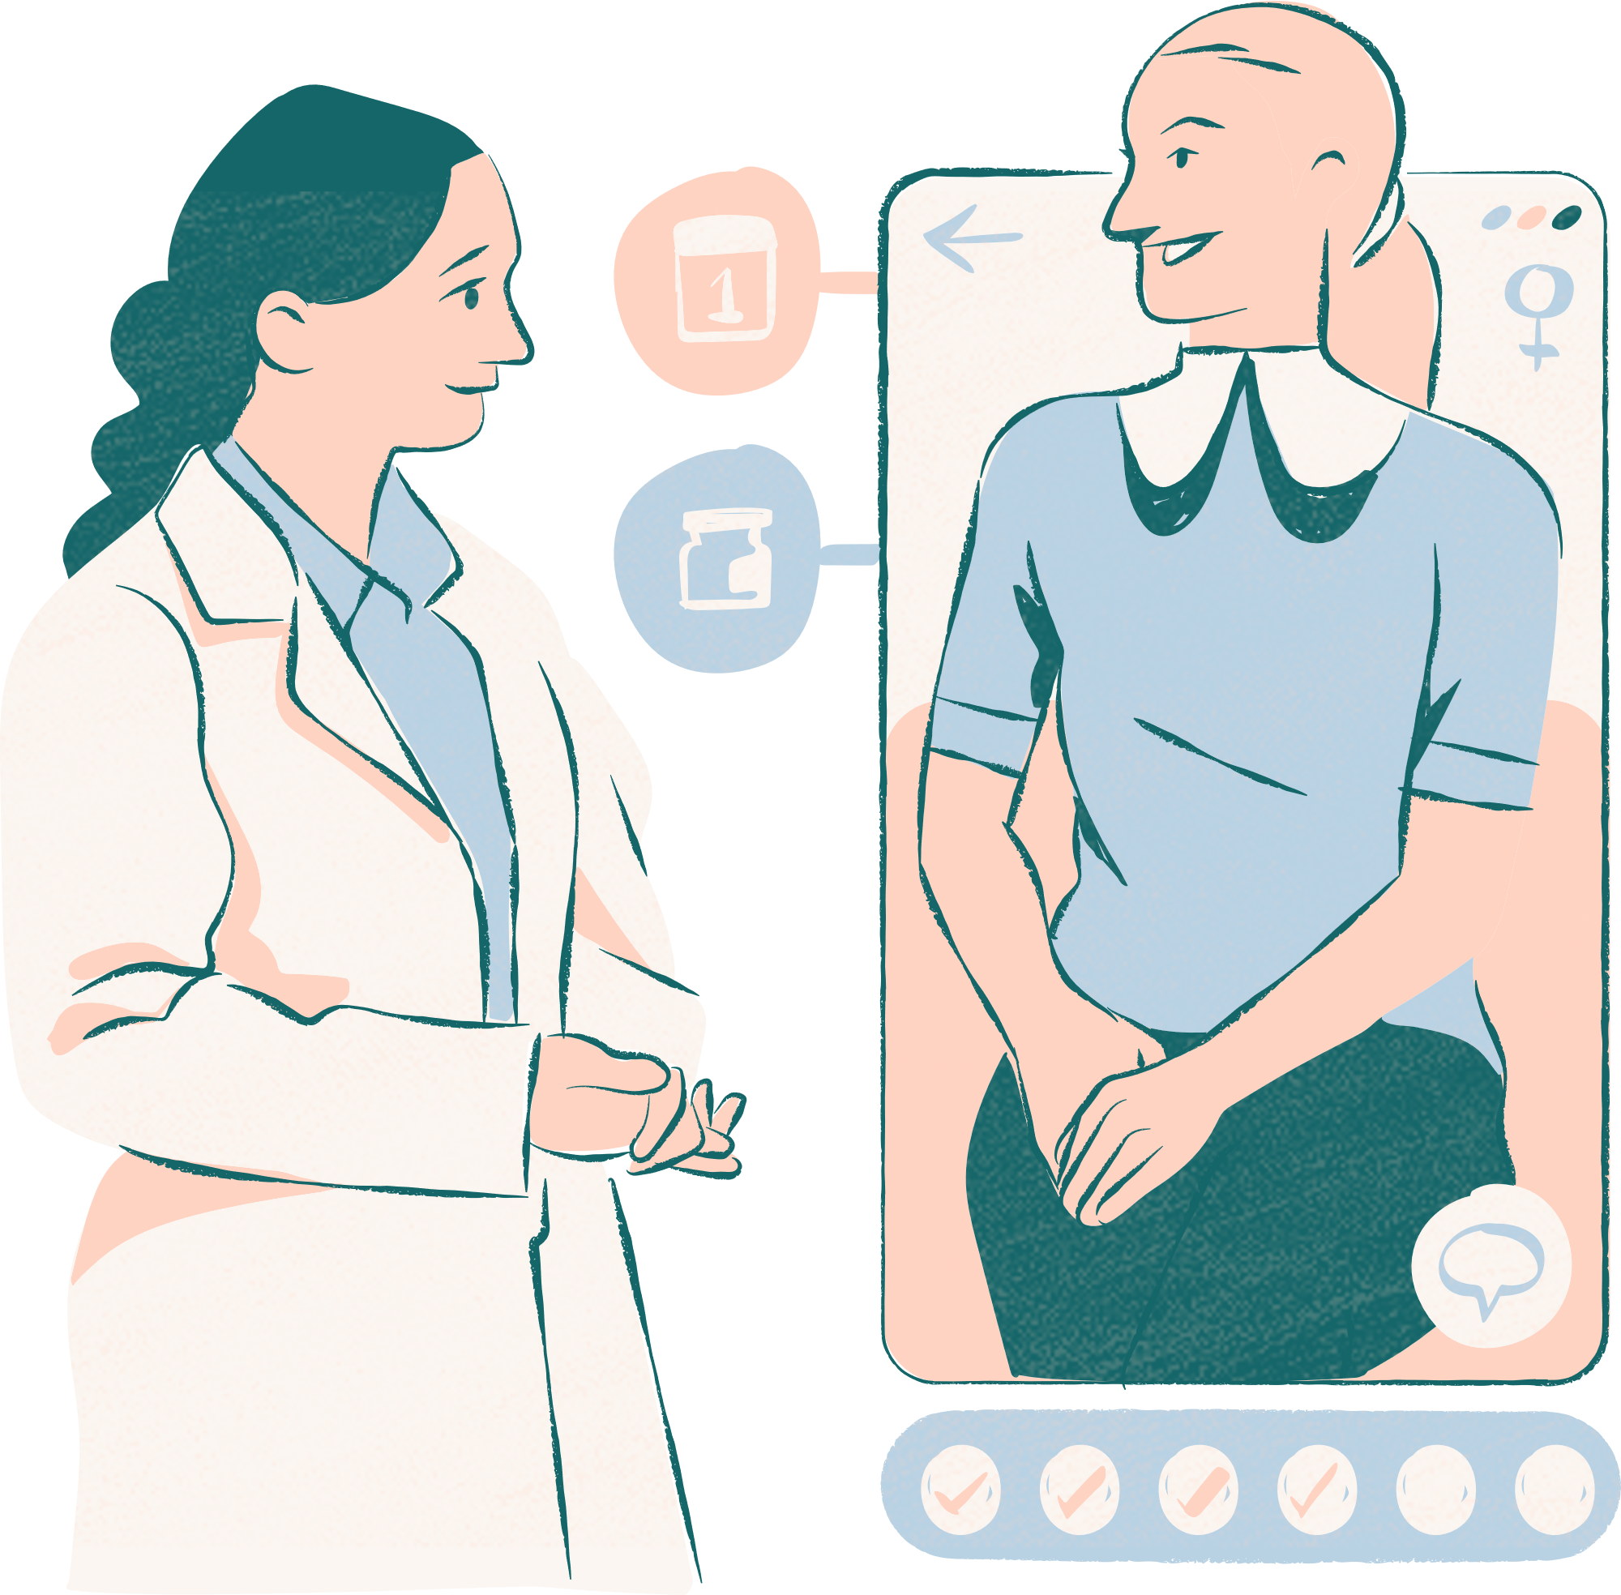
Gluoco Guard
Thank you very much!

